Slide 1
06 | The Pipeline : Deeper
Jeffrey Snover | Distinguished Engineer & Lead Architect
Jason Helmick | Senior Technologist, Concentrated Technology

Slide 2


Course Topics
Getting Started with PowerShell
01 | Don’t fear the shell | 06 | The pipeline : Deeper
02 | The Help system | 07 | The Power in the Shell - Remoting
03 | The pipeline : Getting connected | 08 | Getting prepared for automation
04 | Extending the shell | 09 | Automation in scale - Remoting
05 | Objects for the Admin | 10 | Introducing scripting and toolmaking

Slide 3
Module Overview
How the pipeline really works - The 4 step solution
ByValue
ByPropertyName
What if my property doesn’t match – Customize it!
The Parenthetical – when all else fails

Slide 4
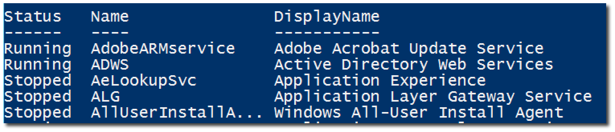
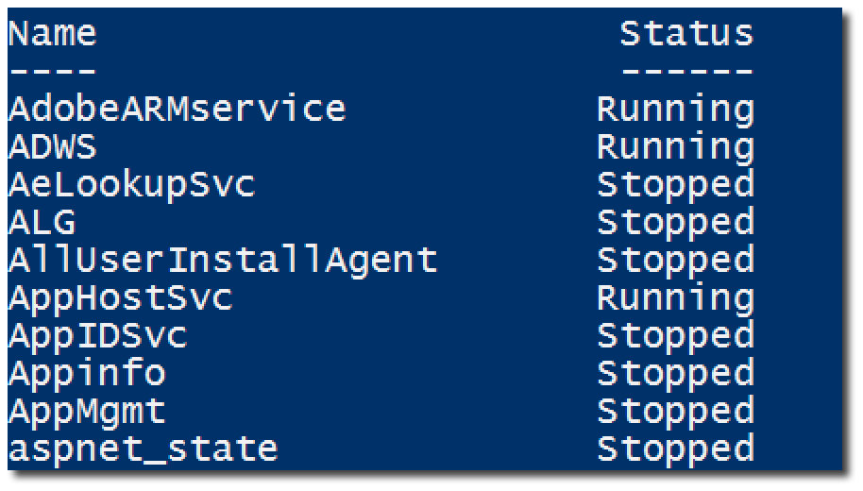
How the pipeline really works - The 4 step solution

Slide 5
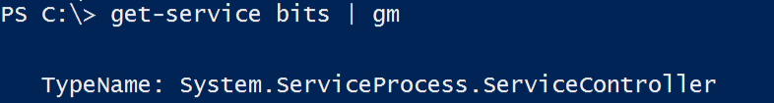

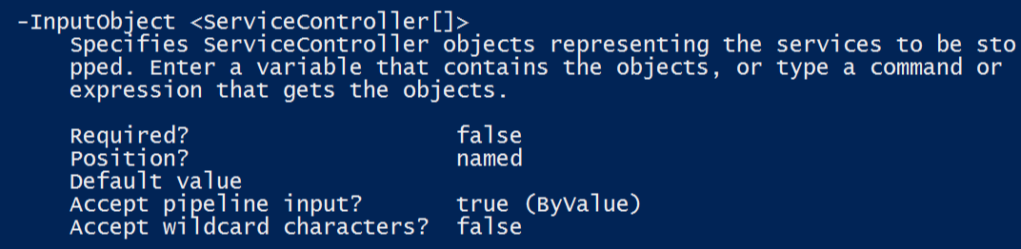
ByValue
1. Get-Service passes ServiceController objects to the pipeline
2. Does Stop-Service accept ServiceController Objects?
3. Help Stop-Service -Full
displays a parameter that accepts ServiceController ByValue

Slide 6
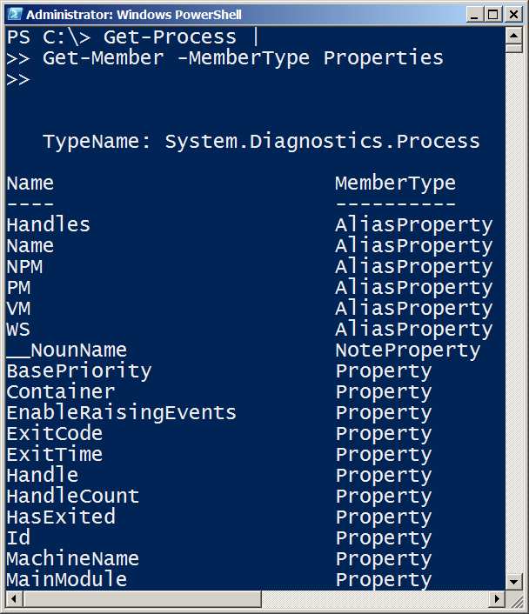


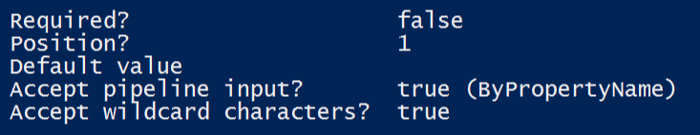

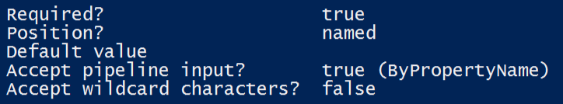

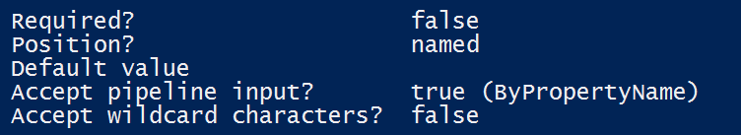
ByPropertyName

Slide 7
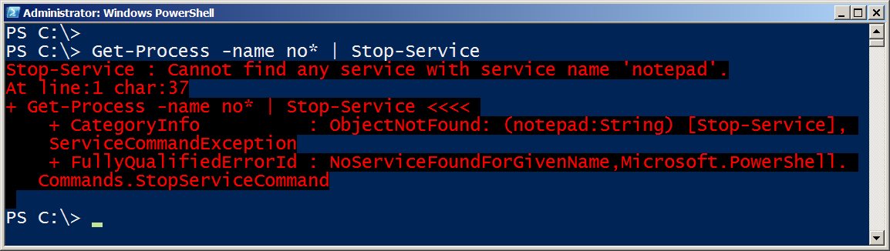


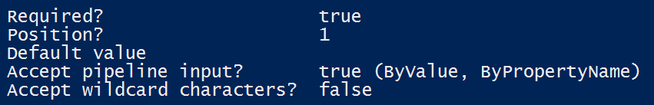
ByPropertyName
1. Get-Process is passing a “Process” Object
2. Stop-Service does not support accepting “Process” objects ByValue, so PowerShell checks what can be accepted ByPropertyName.
3. -Name does accept strings ByPropertyName, and the objects in the pipeline are labeled as a Name property
4. Stop-Service attempts to use the objects for its -Name, in this example, fails

Slide 8
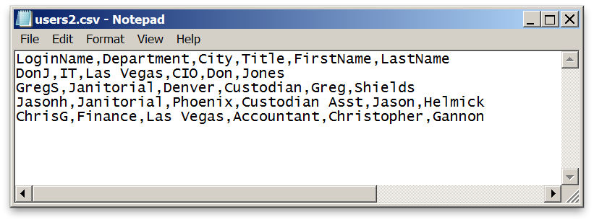
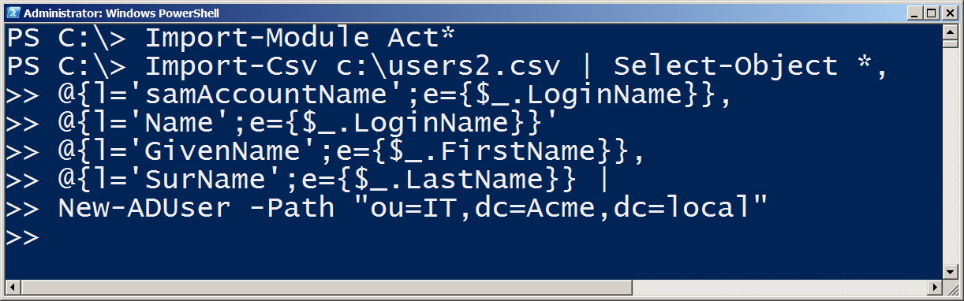
What if my property doesn’t match – Customize it!

Slide 9
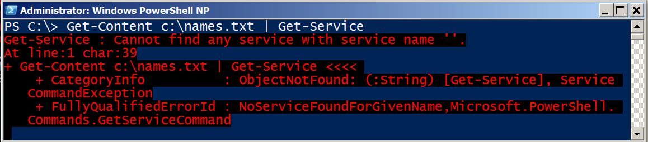
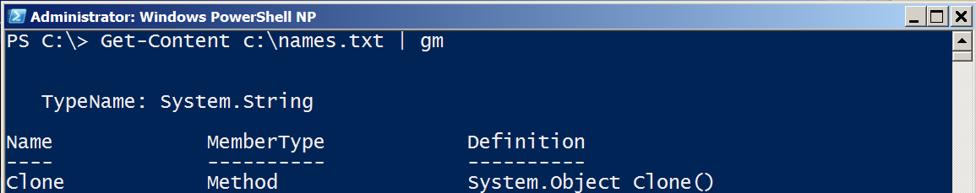
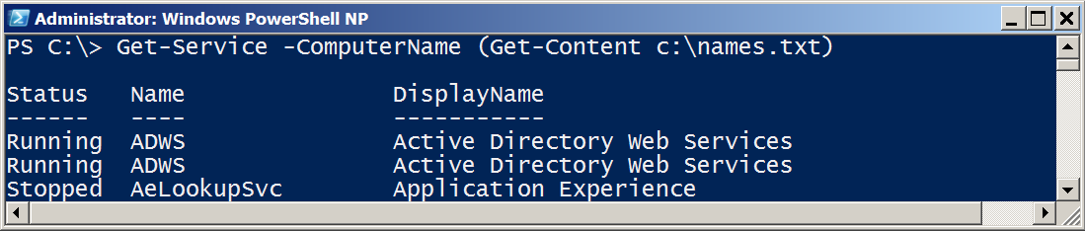
The Parenthetical – when all else fails
1. I want to pass a list of computer names to Get-Service. Why does this fail?
2. -Name and -InputObject accept pipeline input ByValue, not -Computername. -Name accepts text, and then causes the failure.
Parenthesis don’t rely on binding and attach information directly to the desired parameter.

Slide 10
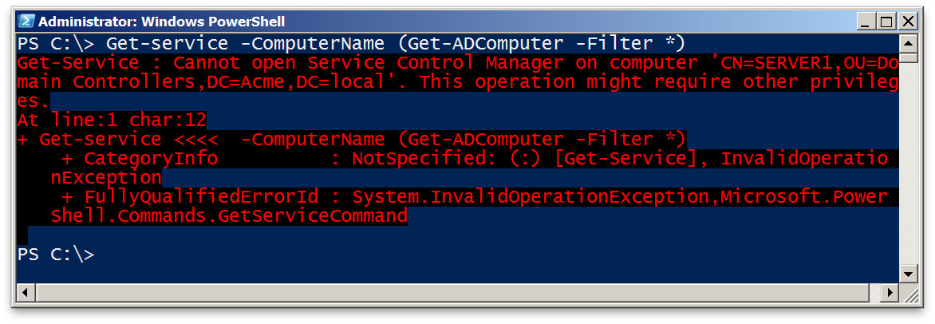


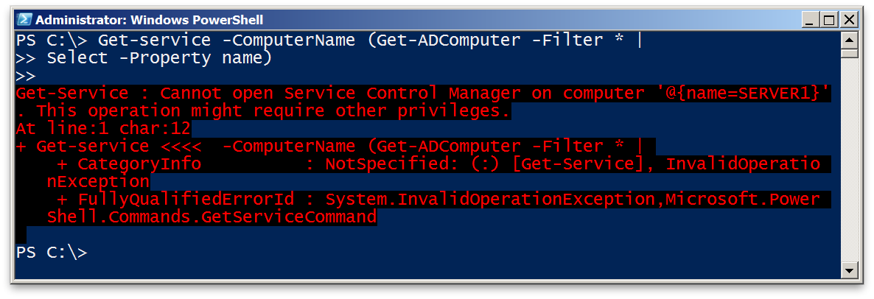

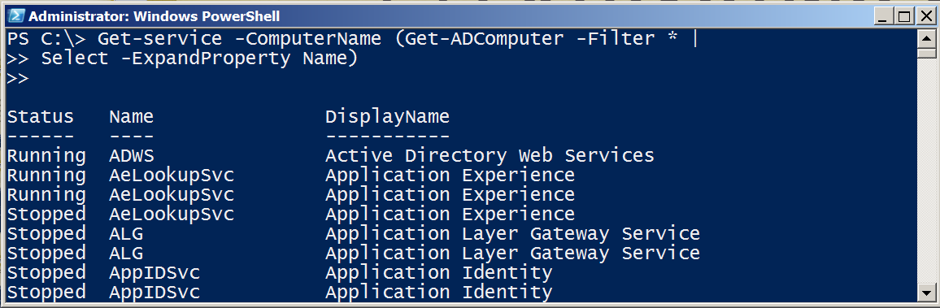
The Parenthetical – when all else fails
Returns a collection (table)
of objects.
Returns string contents

Slide 11
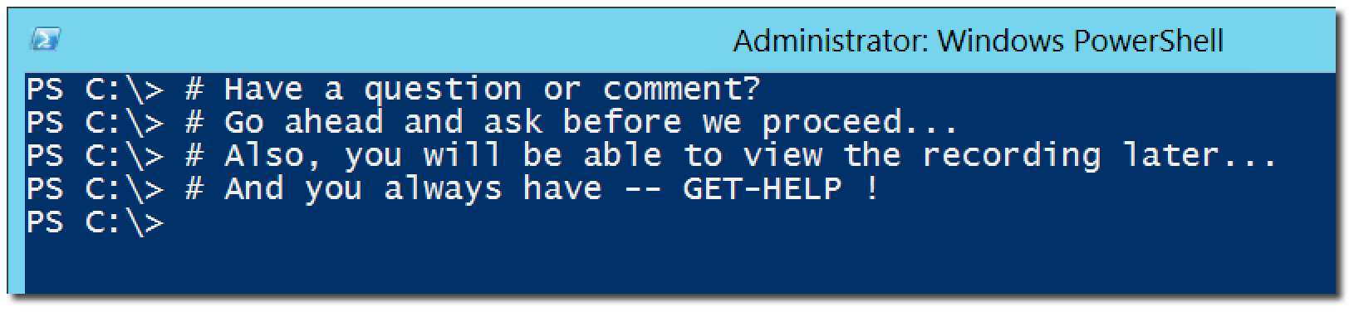
Questions or comments?

